Slide 1
Copy of Property Paper Retrieval
Scenario1 & 2

Slide 2
Process Copy of Property Paper Retrieval (Scenario 1)
Opening Script - Welcome to Grihum Housing Finance Limited. My name is (Agent Name) How may I assist you?
Customer – I want Copy of Property Paper
AI - Please note that this call is being recorded for quality assurance and training purposes.
AI - To verify the information, kindly provide the registered mobile number ( To check the details in finnone slide 3)
AI - Verification - Any 3 of the below verification questions needs to be answered ( To verify the customer details slide 4 )
NAME
Date of Birth
Registered Email ID
Loan Sanction Amount
EMI Amount
AI - Thank you, Sir/Madam. Your verification has been completed.
If there are two LANs, AI should first confirm the specific sanctioned amount, as the LAN number is not remembered by the customer. Once confirmed, proceed with the relevant LAN number. Check Point: FinnOne, Slide 4.
AI - As you requested a copy of the property papers, please note that there is a charge of ₹295, inclusive of 18% GST.
AI - I am sharing the VAN details for the payment. After making the payment, kindly share the payment confirmation/details via email at customercare@grihumhousing.com or contact us on our toll-free number 1800 266 3204. ( To share the VAN details slide from 5 to 10 )
AI – Once the charges are received and you call our toll free number , we will raise the request for a copy of the property papers. The turnaround time (TAT) for providing the documents is 10 working days. ( To raise the request slide from 11 to 20 )
AI - Any other details required apart from this?
Thankyou for calling Grihum Housing Finance Limited. Have a pleasant day!

Slide 3
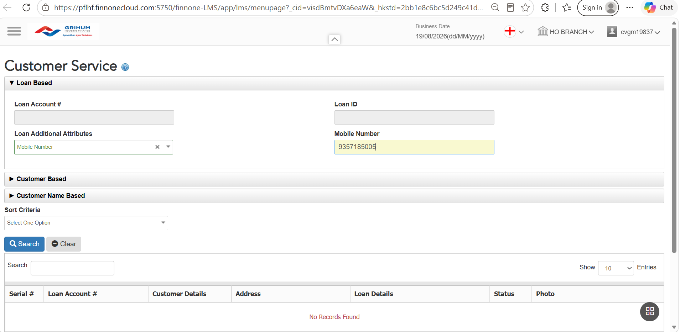
FINONE
To verify the information, please provide the customer's registered mobile number.
​

Slide 4
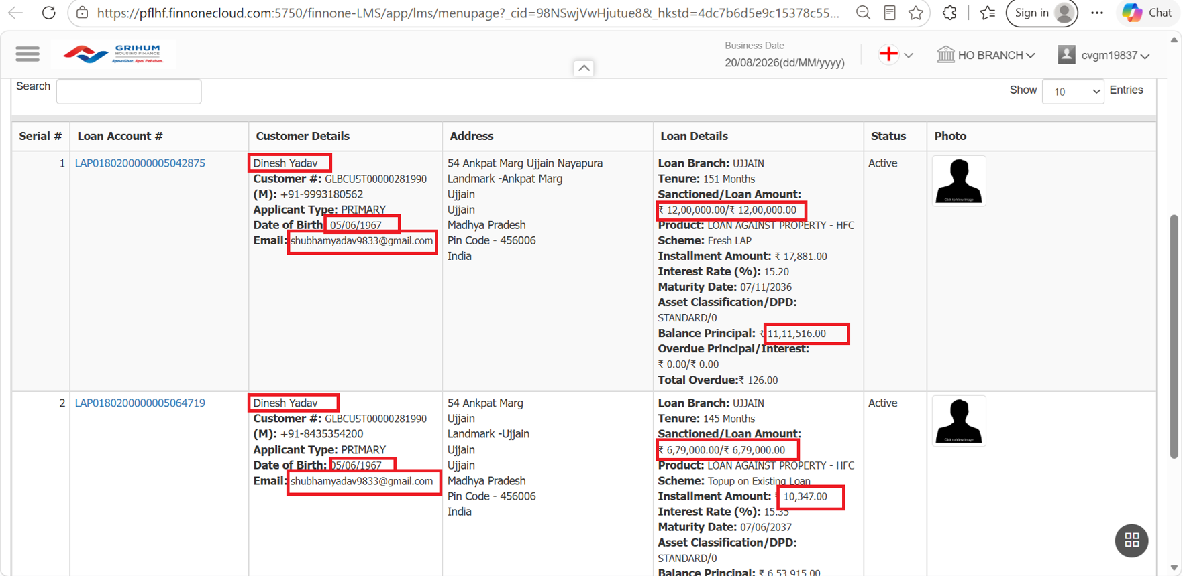
Verification - Any 3 of the below verification questions needs to be answered​

Slide 5
The VAN details will be shared with you via email on your registered email ID.​

Slide 6
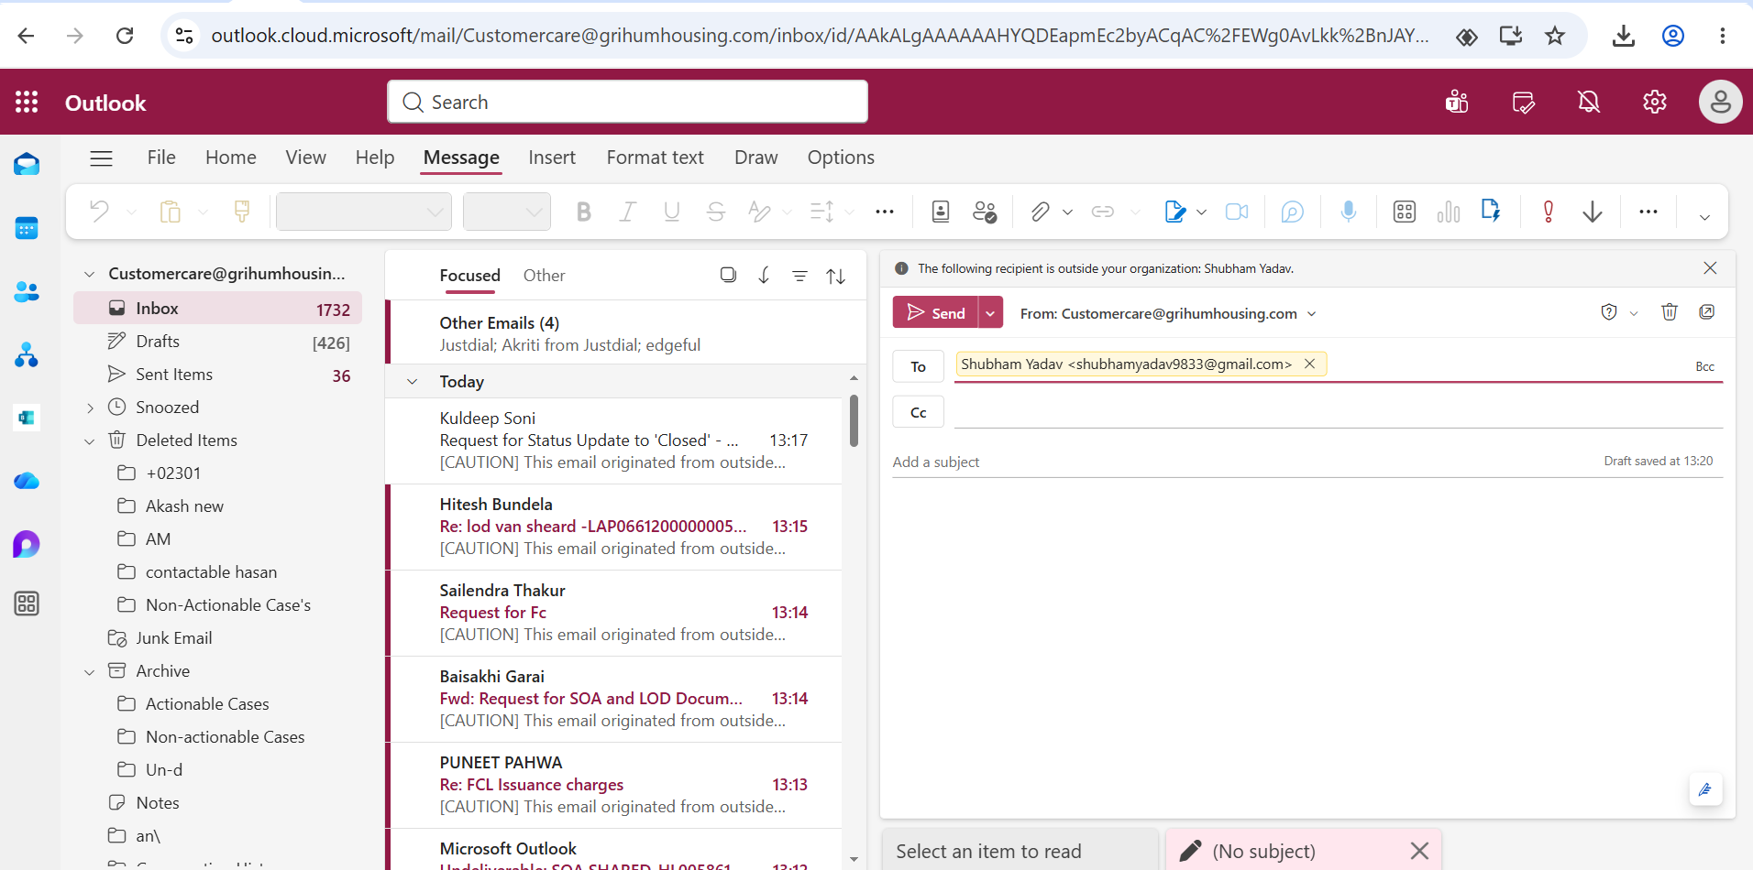
Customer registered email ID

Slide 7
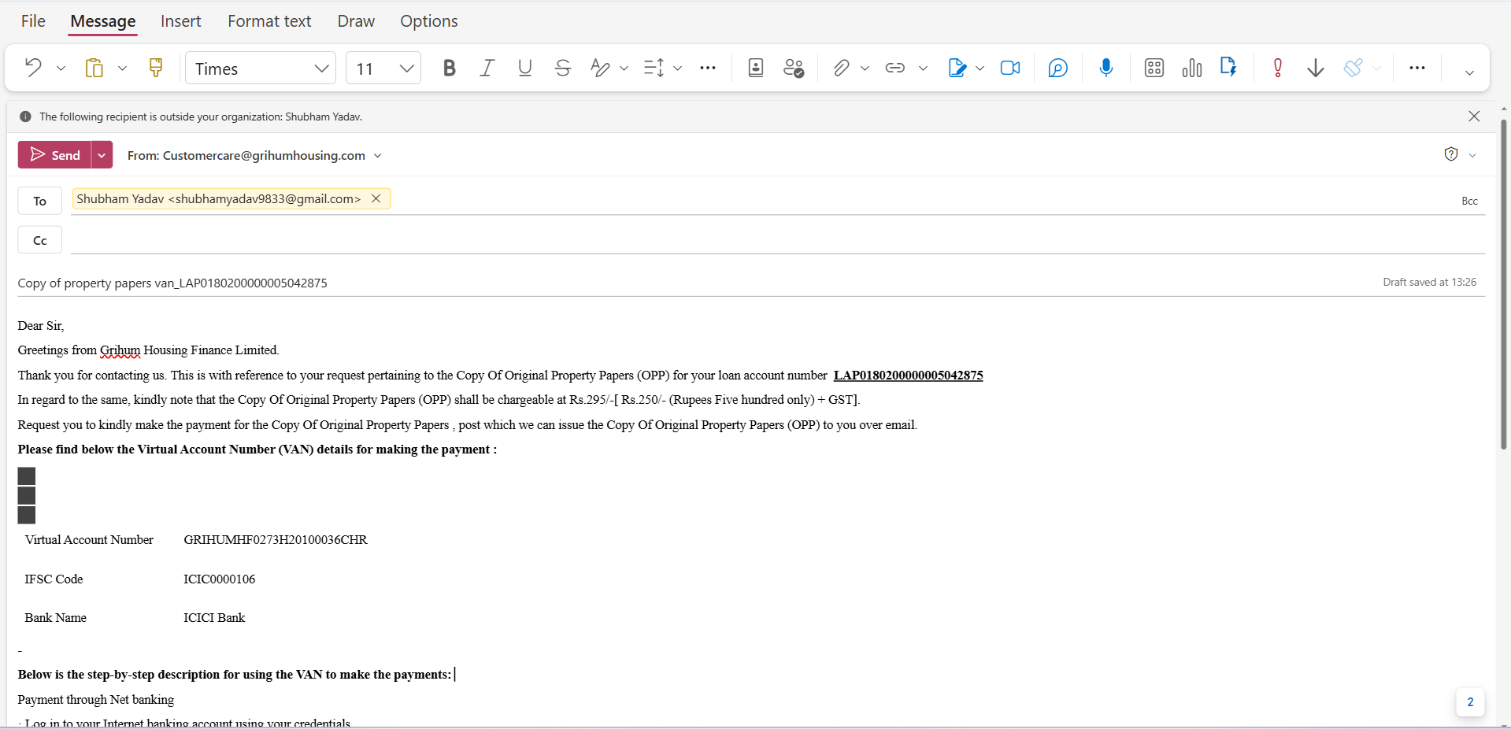
Subject line and email template

Slide 8
Dear Sir ,
Greetings from Grihum Housing Finance Limited.
Thank you for contacting us. This is with reference to your request pertaining to the Copy Of Original Property Papers (OPP) for your loan account number HF0180H21100596.
In regard to the same, kindly note that the Copy Of Original Property Papers (OPP) shall be chargeable at Rs.295/-[ Rs.250/- (Rupees Five hundred only) + GST].
Request you to kindly make the payment for the Copy Of Original Property Papers , post which we can issue the Copy Of Original Property Papers (OPP) to you over email.
Please find below the Virtual Account Number (VAN) details for making the payment :
Virtual Account Number | GRIHUMHF0180H21100596CHR
IFSC Code | ICIC0000106
Bank Name | ICICI Bank
Below is the step-by-step description for using the VAN to make the payments:
Payment through Net banking
· Log in to your Internet banking account using your credentials.
· Locate and select ‘fund transfer’.
· Choose the NEFT/RTGS/IMPS transfer option.
· Enter the recipient bank account details, including the account number (use your Virtual Account Number), name and the bank’s IFSC code.
Payment through UPI payment App

Slide 9
· Log in UPI application · Select the option Bank transfer. · Enter the recipient bank account details, including the account number (use your Virtual Account Number), name and the bank’s IFSC code. We request you to share below mentioned details of payment to assist you further :
1. Date of Payment
2. Amount paid
3. Mode of payment (NEFT/RTGS/QuickPay)
4. UTR number/ Transaction number/ Reference ID
5. Your Bank Name
We hope that you will find the above clarifications and information in line with your requirements and through this communication, we have addressed all your queries, satisfactorily. In case of any further assistance, please email us at customercare@grihumhousing.com through your registered email id, quoting your loan account number. You may also reach out to us at our customer care no. at 1800-266-3204.
Thanks & Regards,
Customer Care Team.
The details highlighted in red and bold can modify

Slide 10
Types of VAN ( Virtual Account Number )​
​
​
EG- LAP0117200000005050628 - Last 7 digit ​
LAN HL0011420100007 - Full LAN ​
​
VAN - GRIHUM5050628CHR
GRIHUMHL0011420100007CHR
​
IFSC CODE - ICIC0000106 Bank NAME -ICICI BANK ​
​
​
​
​
Definition: - For a 22-digit Loan Account Number, use the last 7 digits only. For a 15-digit or 18-digit Loan Account Number, use the entire Loan Account Number. ​
​
​

Slide 11
Process Copy of Property Paper Retrieval(Scenario 2)
Opening Script - Welcome to Grihum Housing Finance Limited. My name is (Agent Name) How may I assist you?
Customer – I want Copy of Property Paper .I have made the payment of Rs.590 for LOD.
AI - Please note that this call is being recorded for quality assurance and training purposes.
AI - To verify the information, kindly provide the registered mobile number ( To check the details in finnone slide 12 )
AI - Verification - Any 3 of the below verification questions needs to be answered ( To verify the customer details slide 13 )
NAME
Date of Birth
Registered Email ID
Loan Sanction Amount
EMI Amount
AI - Thank you, Sir/Madam. Your verification has been completed.
If there are two LANs, AI should first confirm the specific sanctioned amount, as the LAN number is not remembered. Once confirmed, proceed with the relevant LAN number. Check Point: FinnOne, Slide 13.
AI - As you have paid the charges of copy of the property papers, I will check whether the amount is reflecting in our system.
(Need to check whether the amount is reflecting in our system – Refer Slide 14 to 27 )
AI - Sir, we have received your charges , hence raising a request from our end ( To raise the request slide from 18 to 20 )
AI – After 10 working days, kindly visit the nearest Grihum branch & contact us on our toll-free number 1800 266 3204. We will share the copy of the property papers with the branch representative, and you may collect the documents from the branch.
AI - Any other details required apart from this?
Thankyou for calling Grihum Housing Finance Limited. Have a pleasant day!

Slide 12
FINONE
To verify the information, please provide the customer's registered mobile number.
​

Slide 13
Verification - Any 3 of the below verification questions needs to be answered​

Slide 14
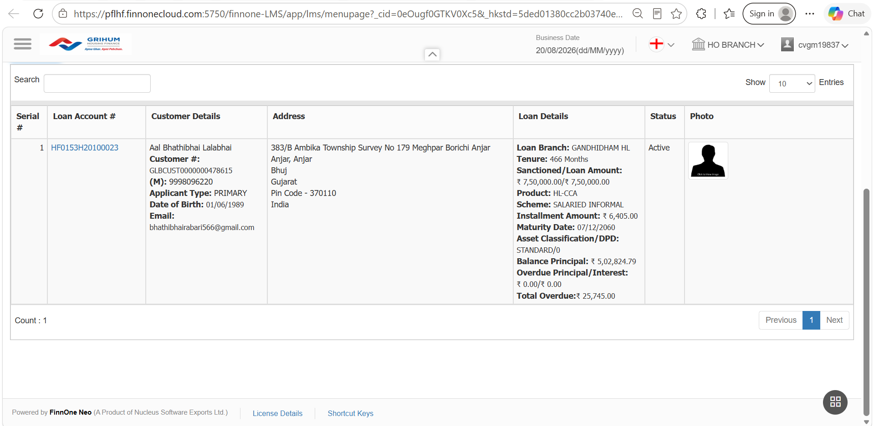
SOA Reflecting in FinnOne

Slide 15
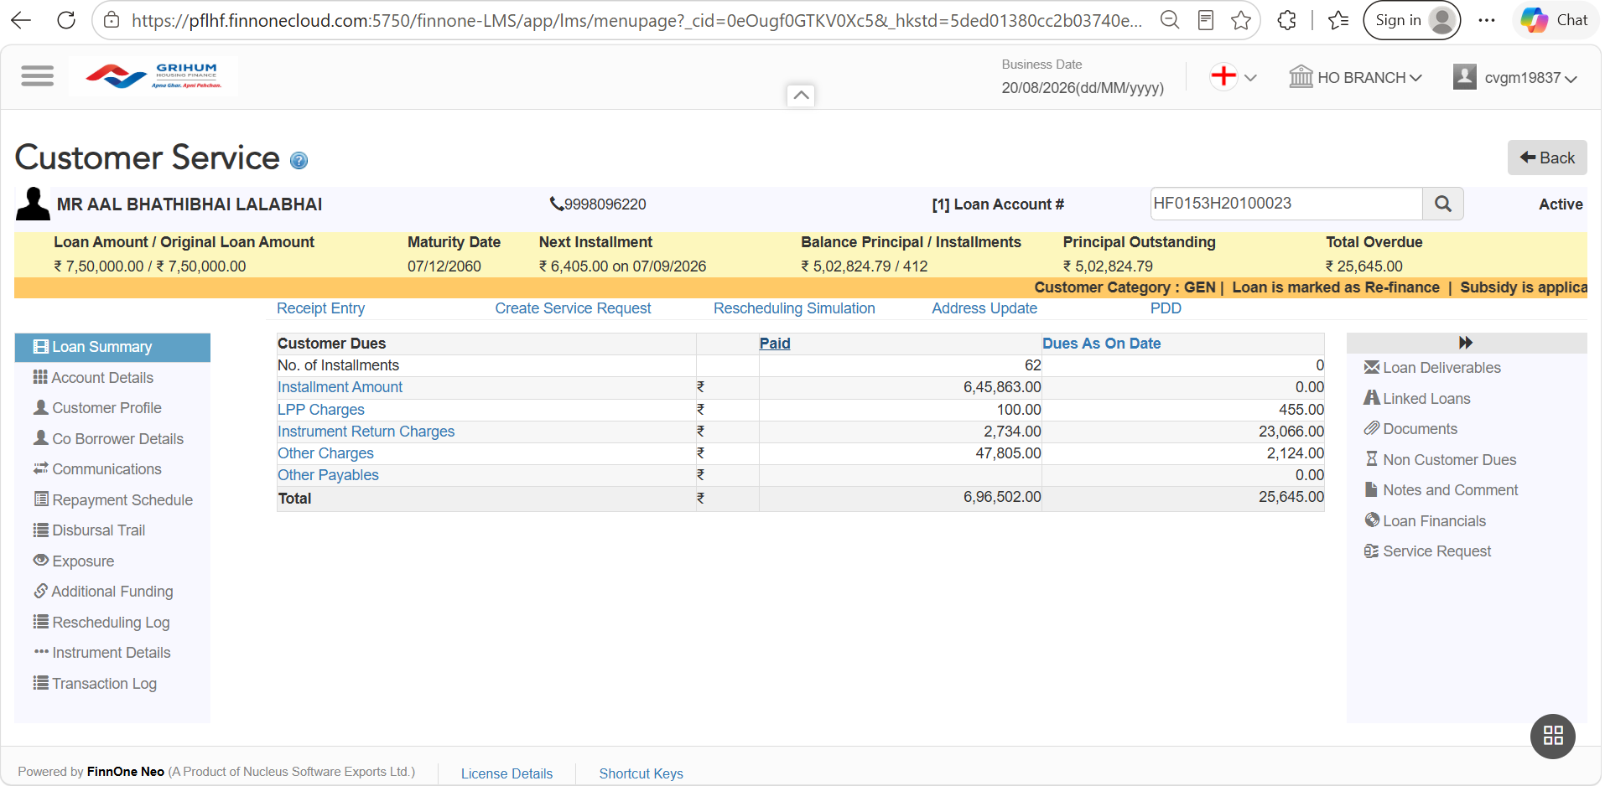

Slide 16
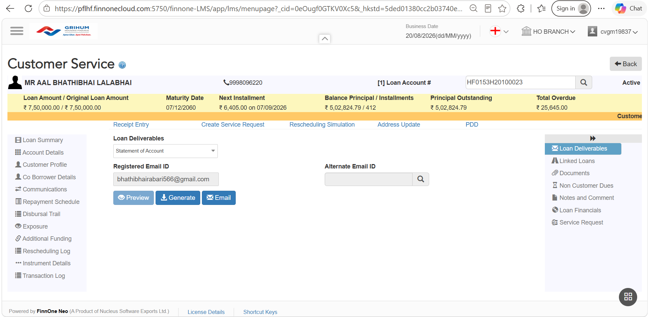

Slide 17
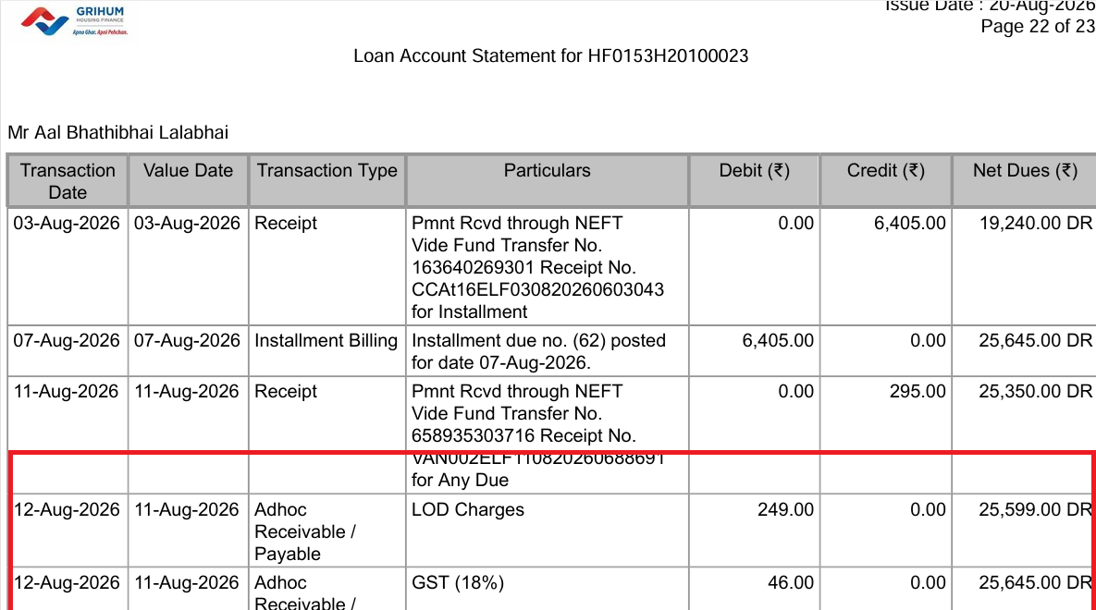

Slide 18
CSR Tagging

Slide 19
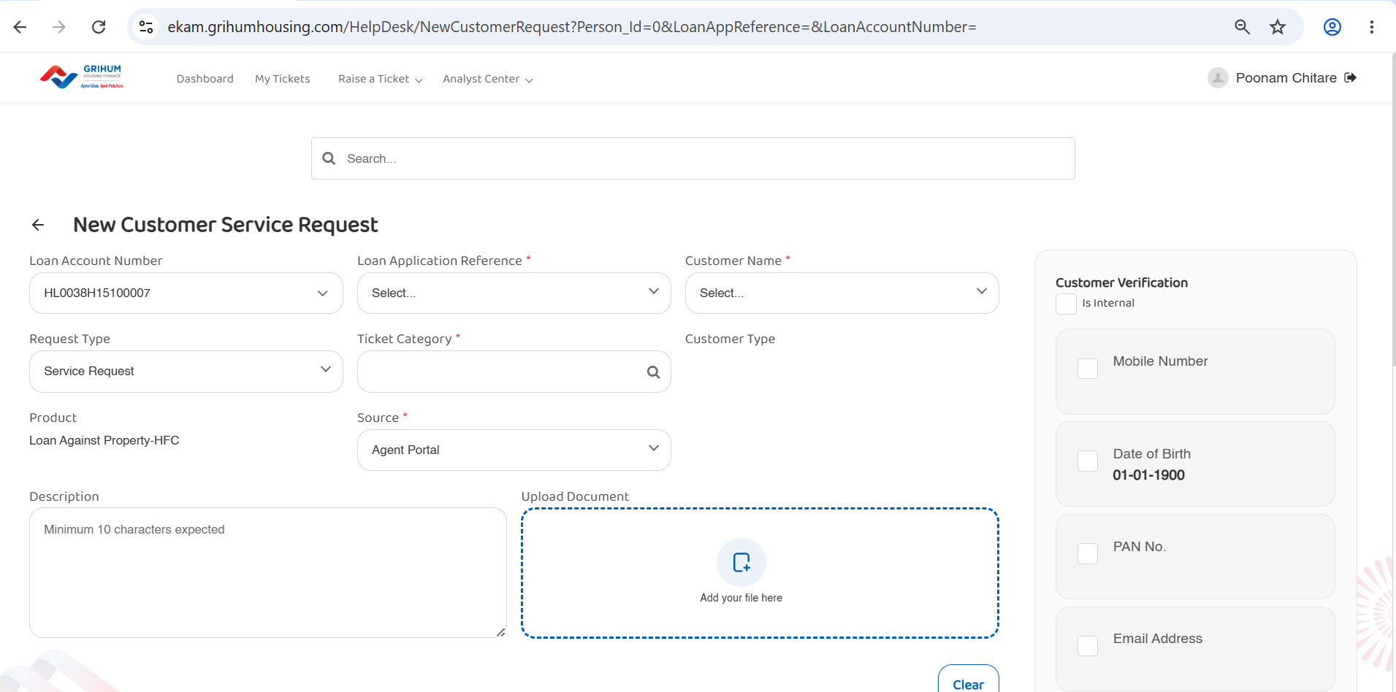

Slide 20
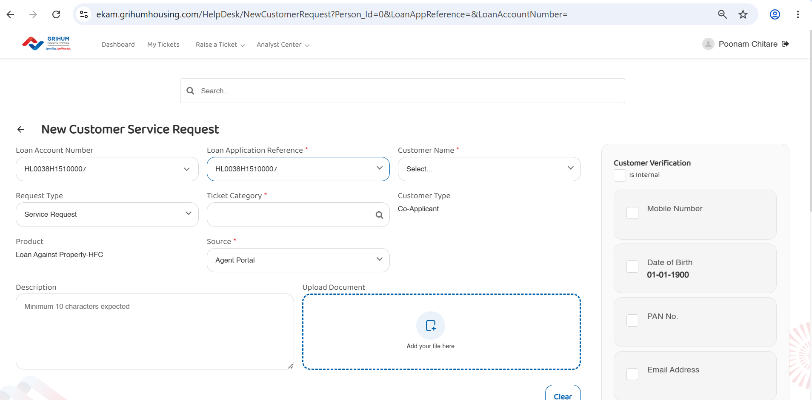

Slide 21
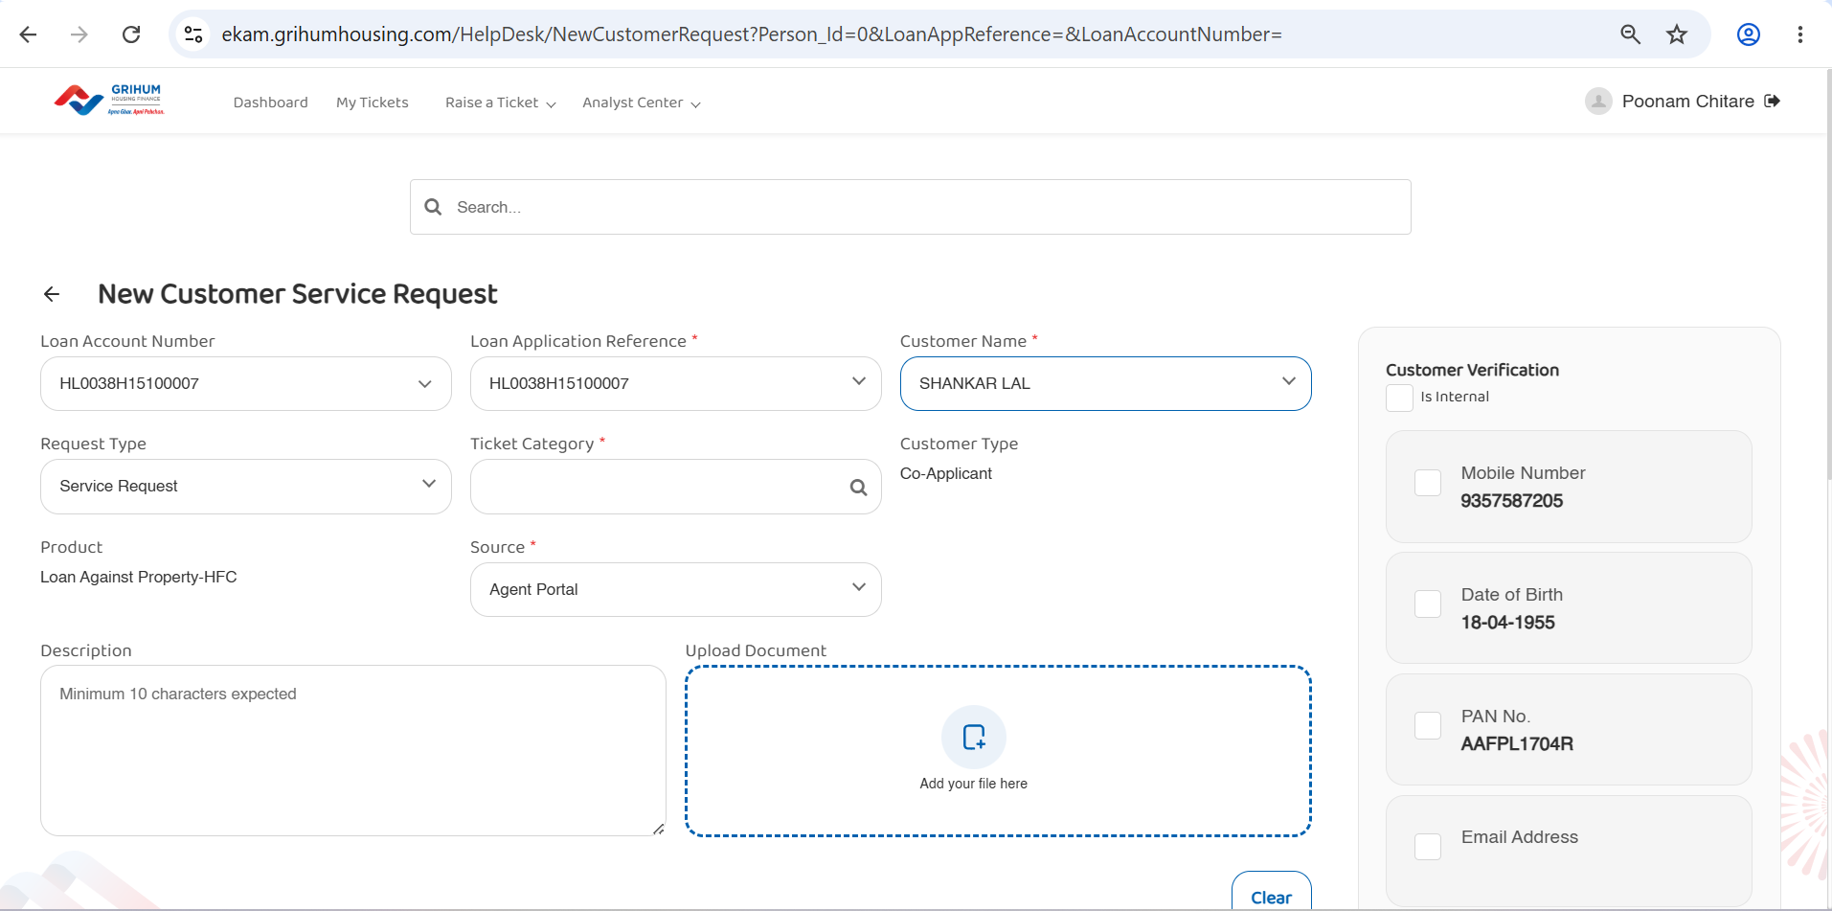

Slide 22
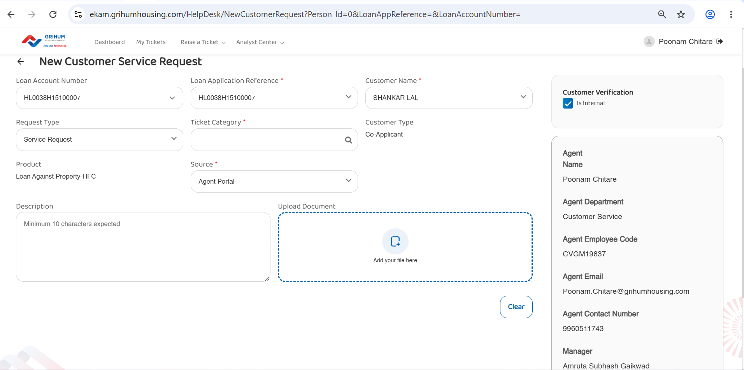

Slide 23
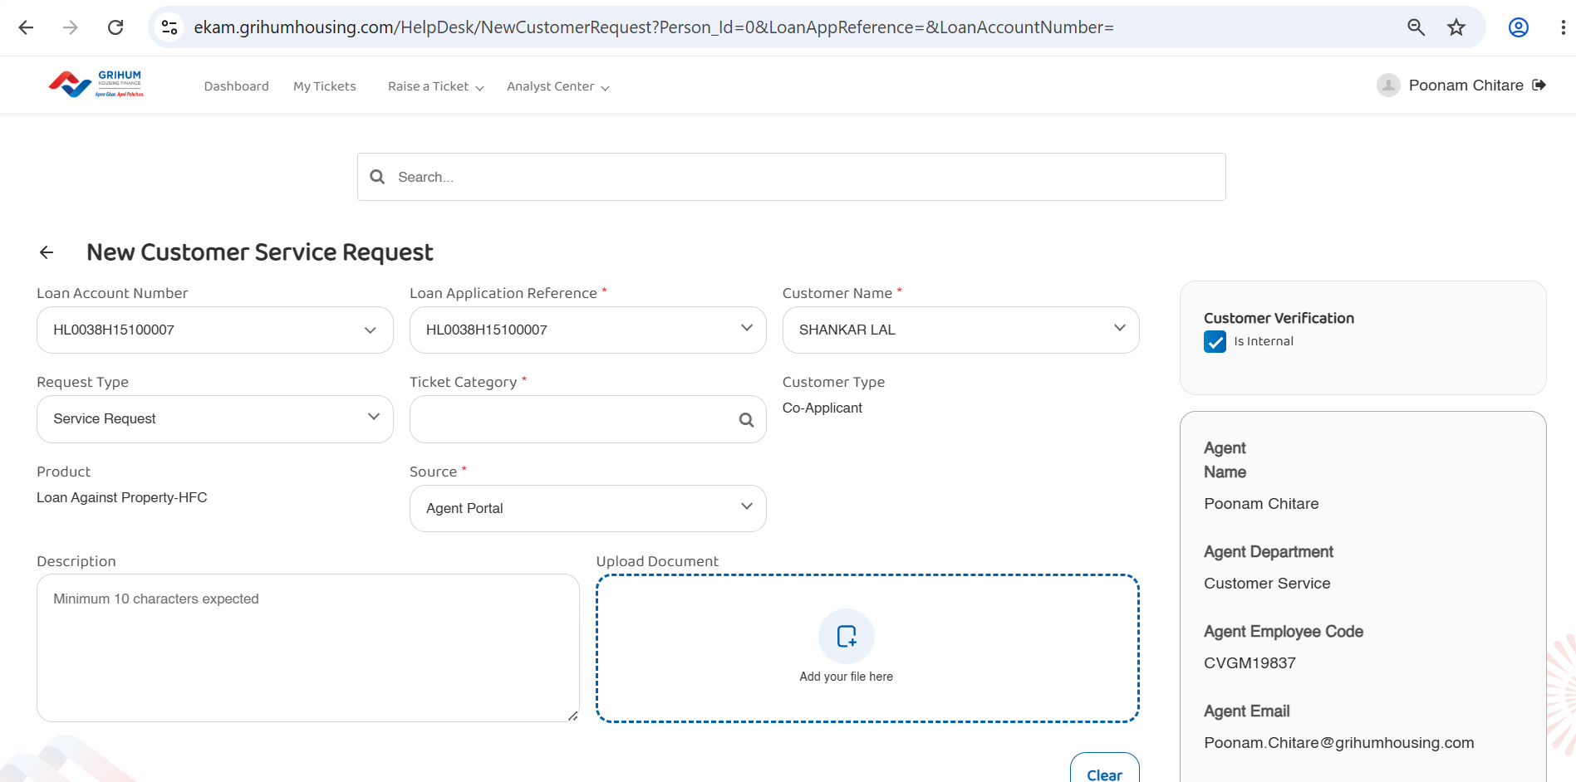

Slide 24
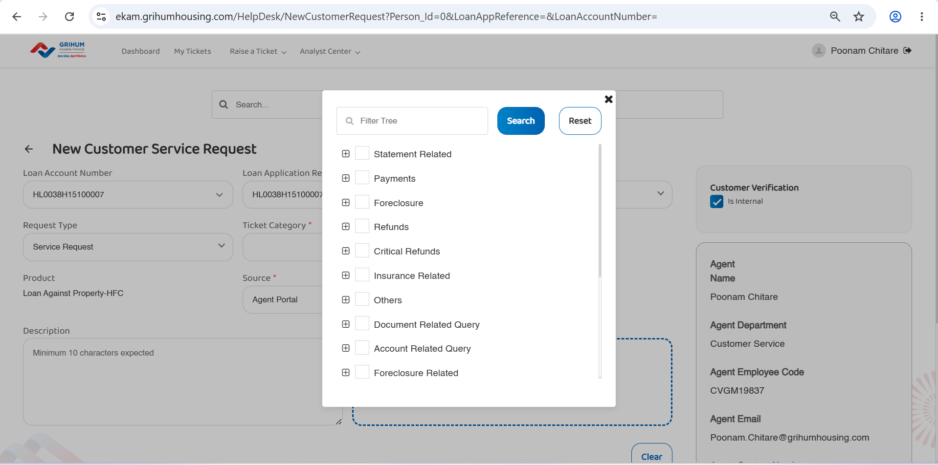

Slide 25
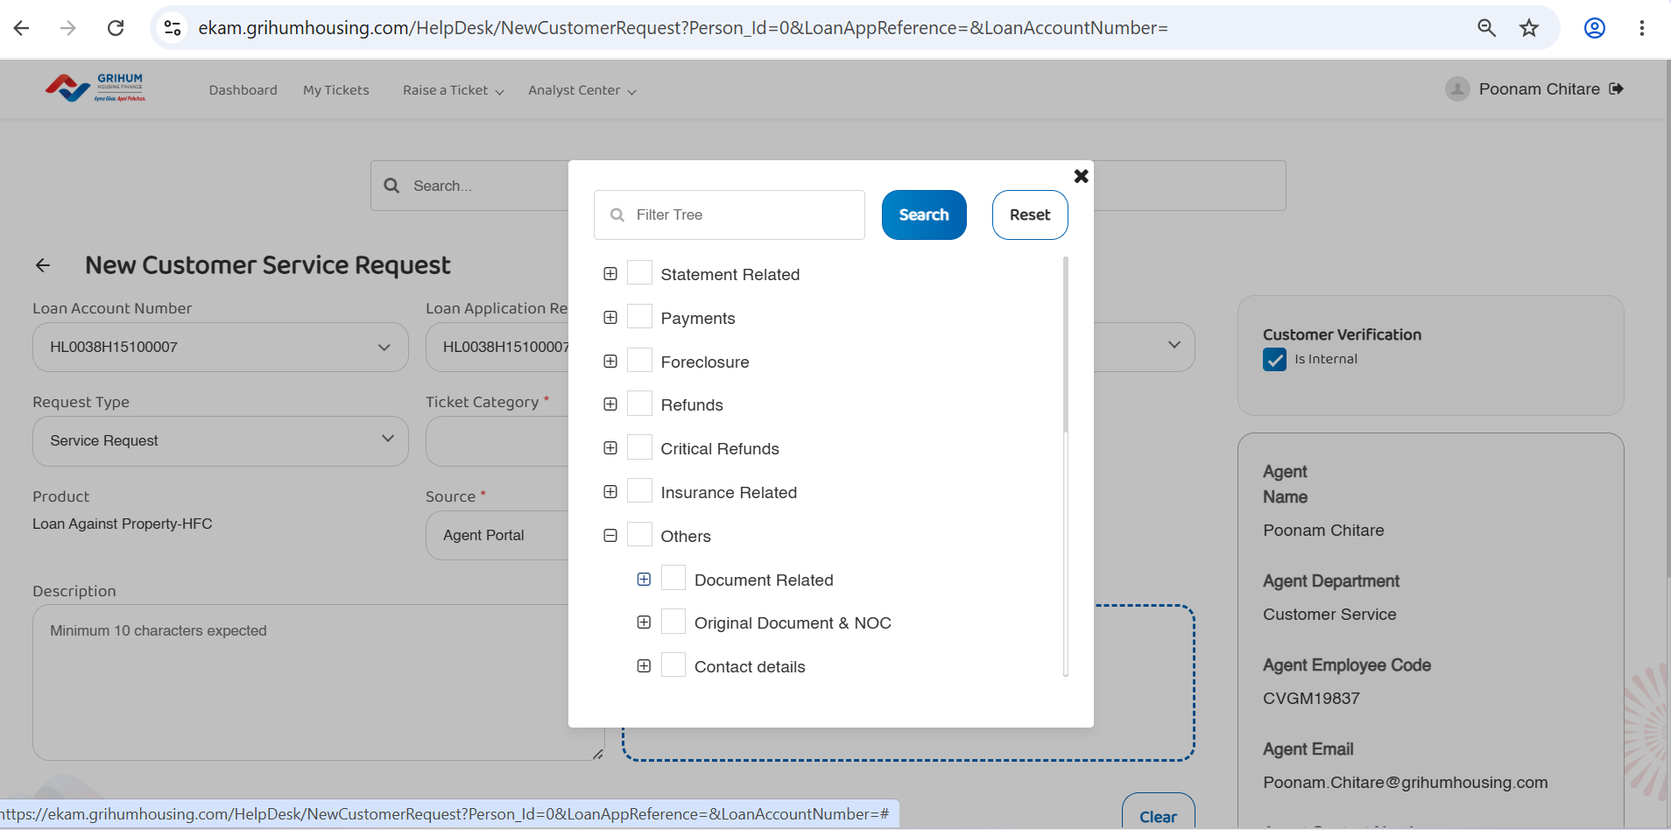

Slide 26
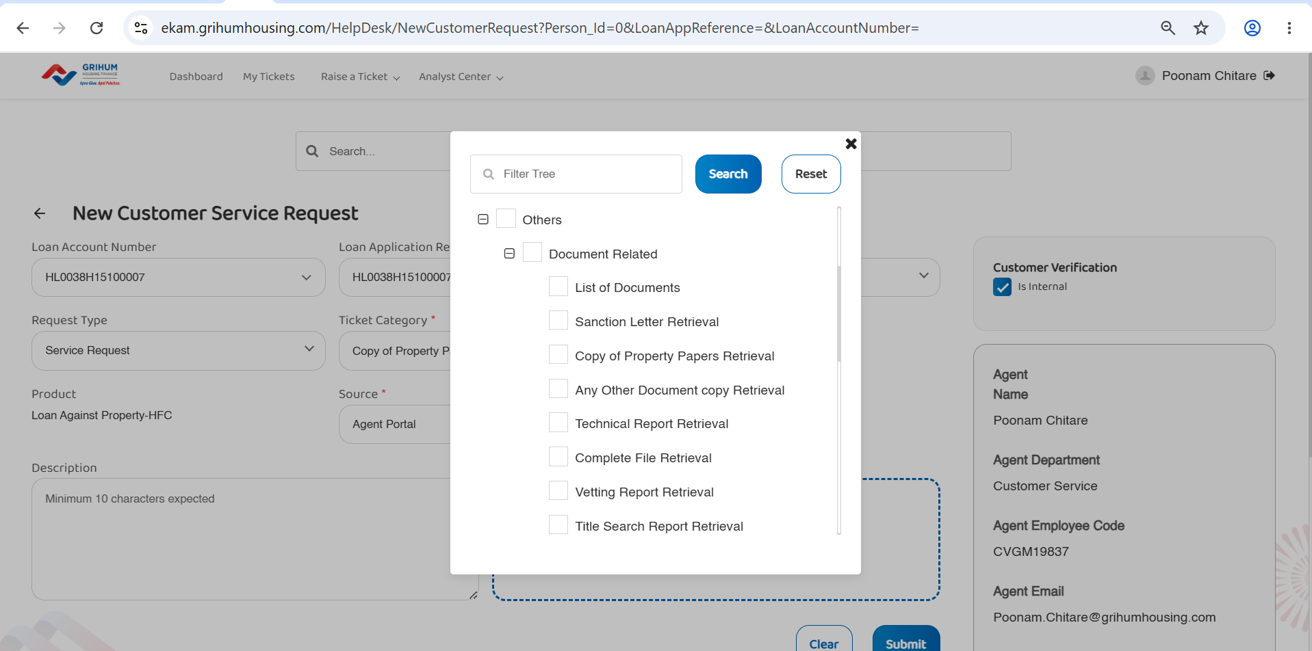

Slide 27
